Slide 1

ECE 530 Cloud Computing
Ioannis Papapanagiotou
Microservices

Slide 2
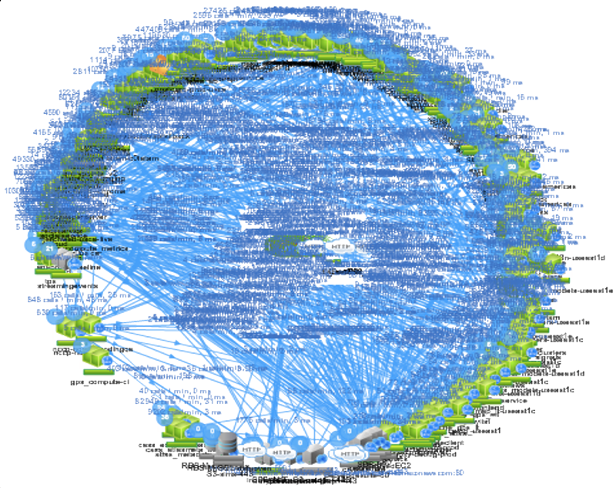
Netflix service ecosystem

Slide 3
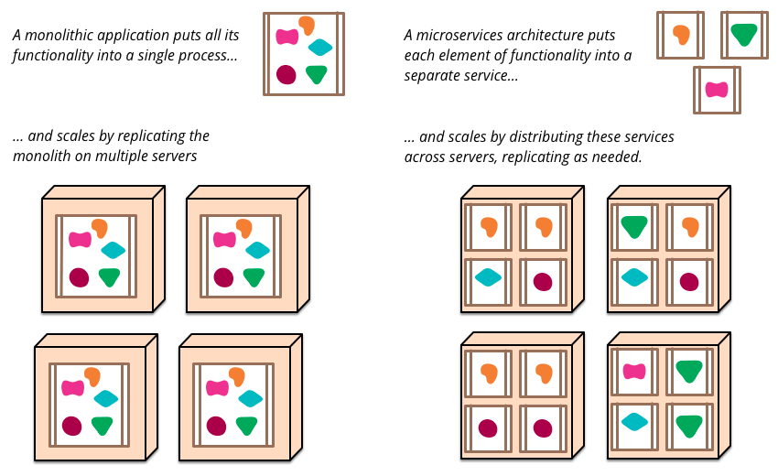
Microservice style vs Monolythics

Slide 4
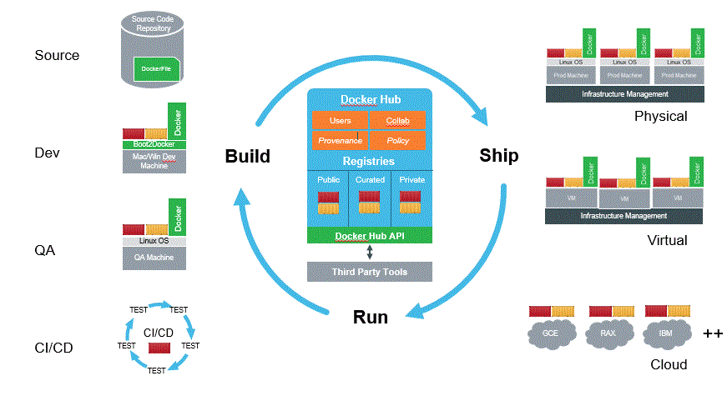
Microservices
Microservice architectural style: developing a single application as a suite of small services, each running in its own process and communicating with lightweight mechanisms, e.g. REST API.
Notes:
Source: http://blog.docker.com/category/registry-2/
. Over time it's often hard to keep a good modular structure, making it harder to keep changes that ought to only affect one module within that module. Scaling requires scaling of the entire application rather than parts of it that require greater resource.

Slide 5
So why Microservices?
Fast deployment: Code changes for each service can be made independently (as long as the API contract with other services isn’t violated) and therefore, build+test+deploy cycles speed up dramatically.
Netflix, for example, deploys code a hundred times in a single day thanks to the early adoption of the microservices architecture!
Efficient scaling: Each microservice can be scaled independently,
a much more efficient way of scaling an application, because not every part of an application experiences the same amount of load and needs to be scaled equally.
Design autonomy: Developers get the freedom to employ different technologies, frameworks, and design patterns to design and implement each microservice,
pursuing a horses for the courses strategy as necessary.
Move Fast, Fail Fast (and Small)

